Slide 1

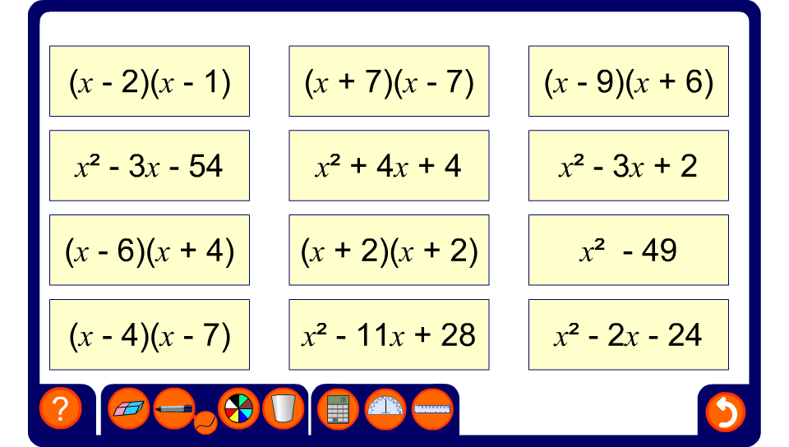


Matching quadratic expressions 1
Notes:
Select a bracketed expression and ask a volunteer to find its corresponding expansion.

Slide 2
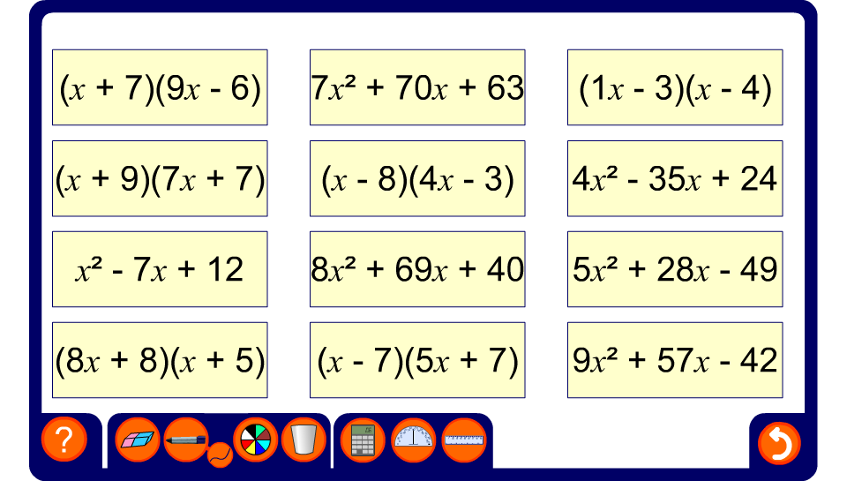
Matching quadratic expressions 2
Notes:
Select a bracketed expression and ask a volunteer to find its corresponding expansion.

